Slide 1

RUNGTA COLLEGE OF DENTAL SCIENCES & RESEARCH
FRACTURES OF MAXILLA AND MANDIBLE
DEPARTMENT OF PEDODONTICS AND PREVENTIVE DENTISTRY

Slide 2
SPECIFIC LEARNING OBJECTIVES
Core areas | Domain
Introduction Incidence | Mandibular dislocation references

Slide 3
CATEGORY
MUST TO KNOW
NICE TO KNOW
Facial fractures in children
DESIRE TO KNOW
Mandibular dislocation
Incidence
Management of maxillofacial trauma

Slide 4
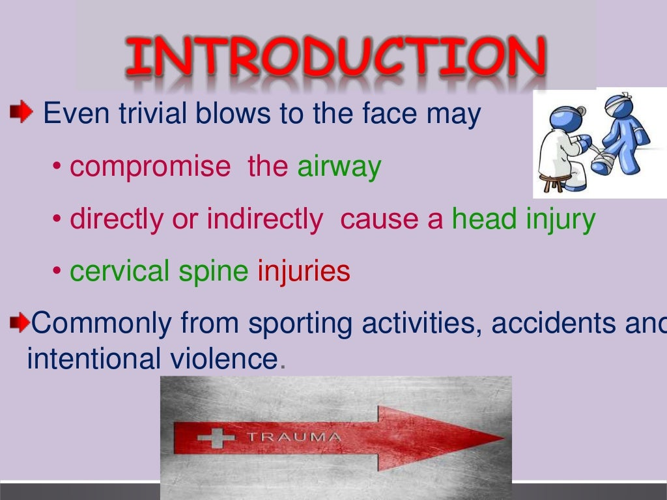

Slide 5
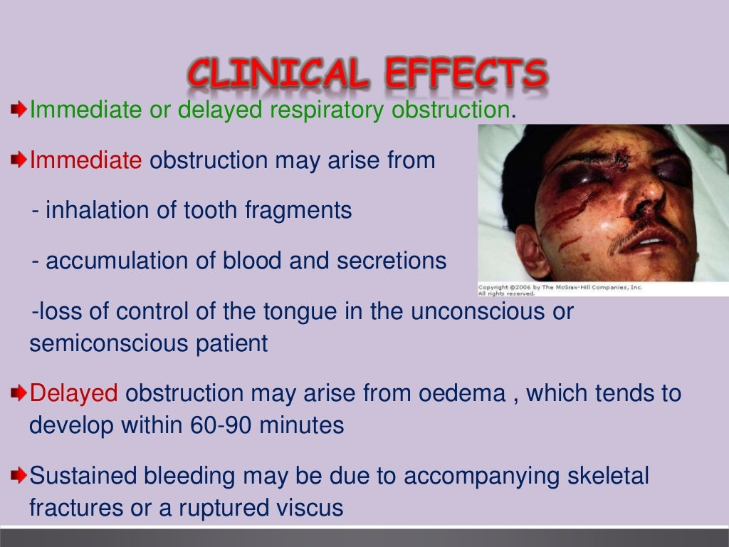

Slide 6
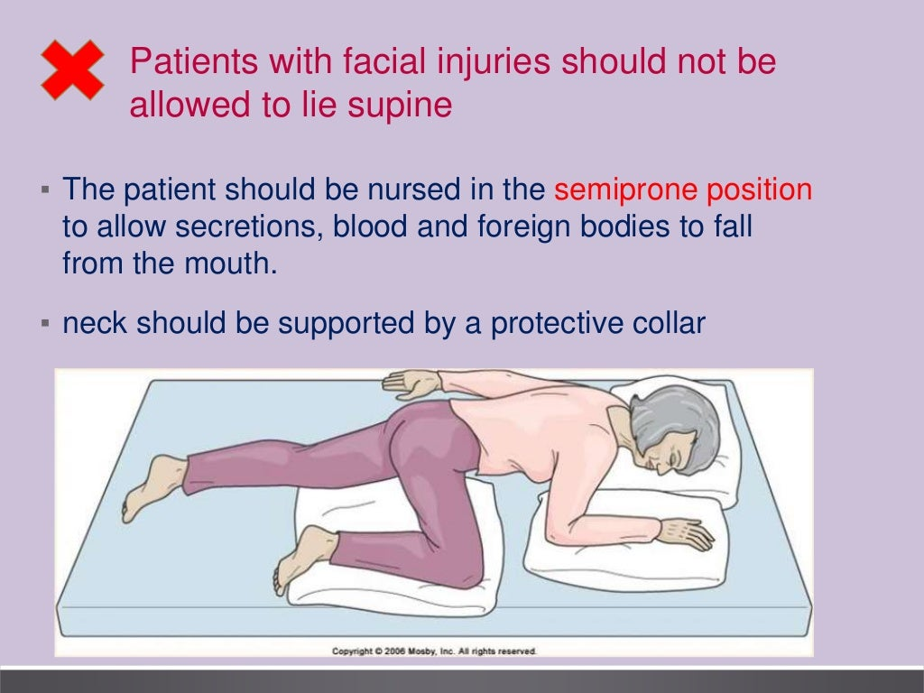

Slide 7
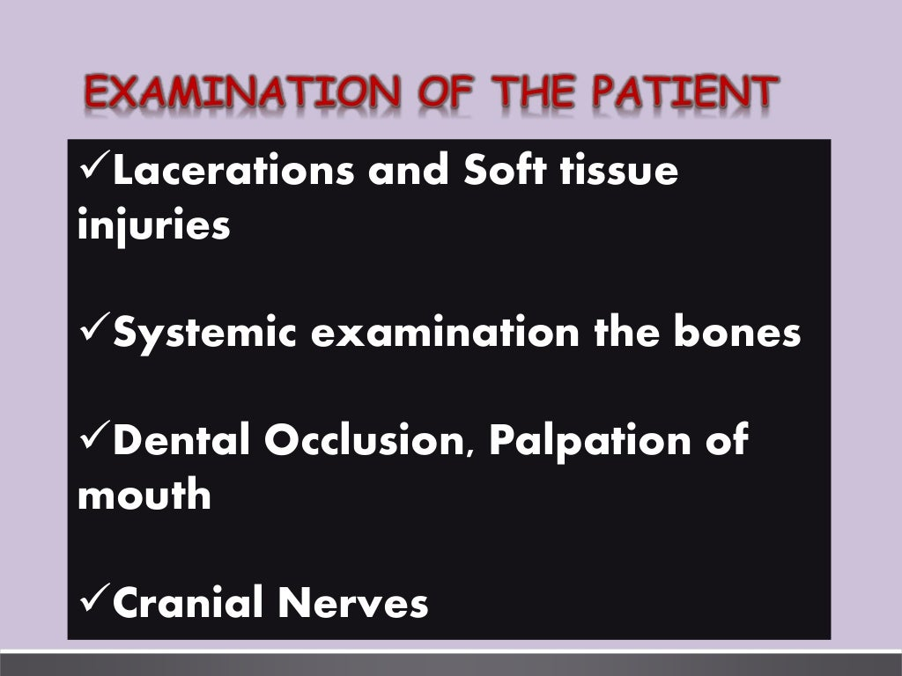

Slide 8
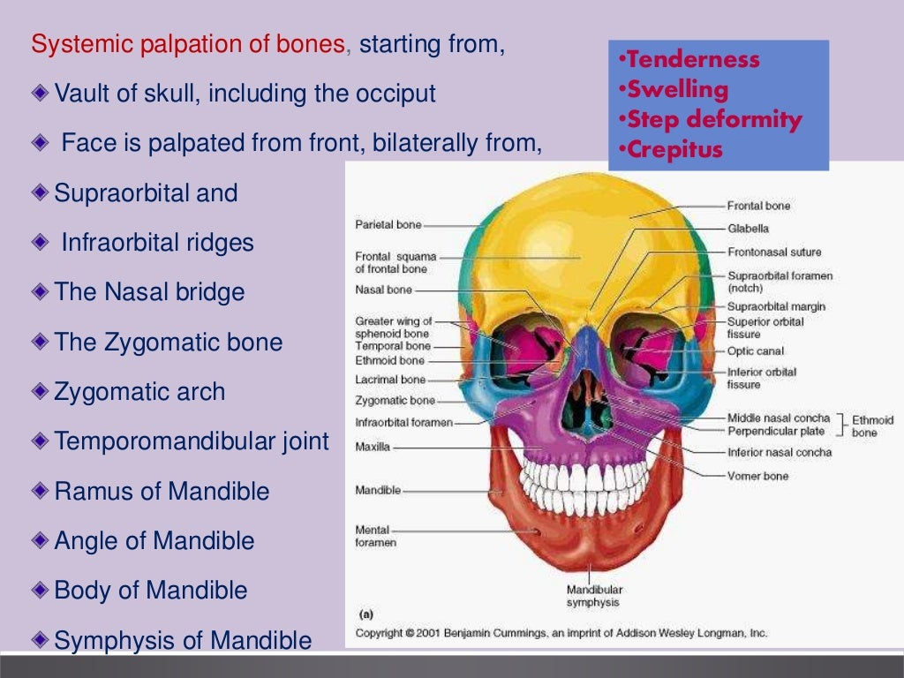

Slide 9
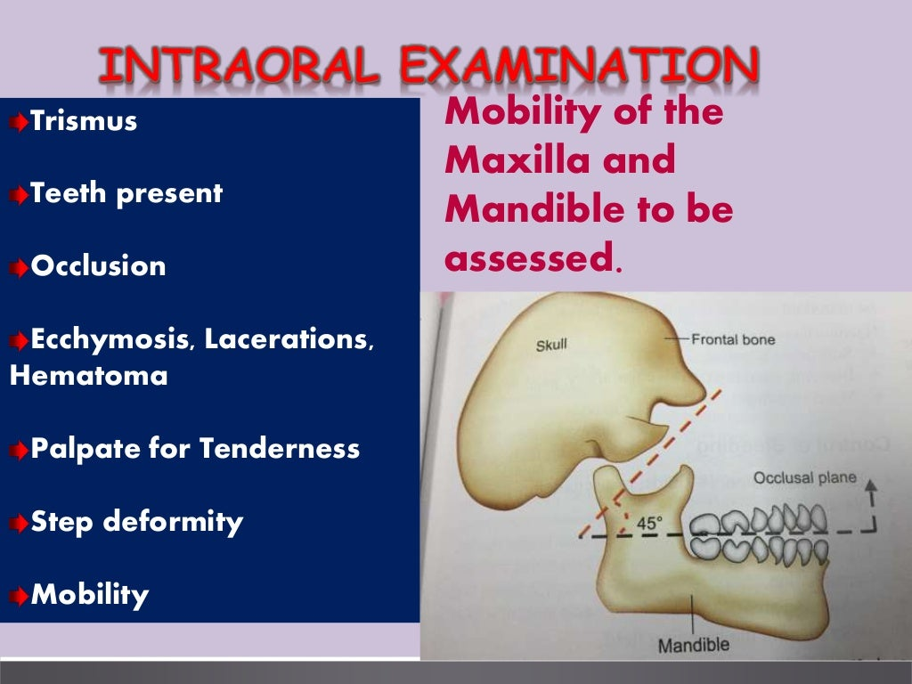

Slide 10
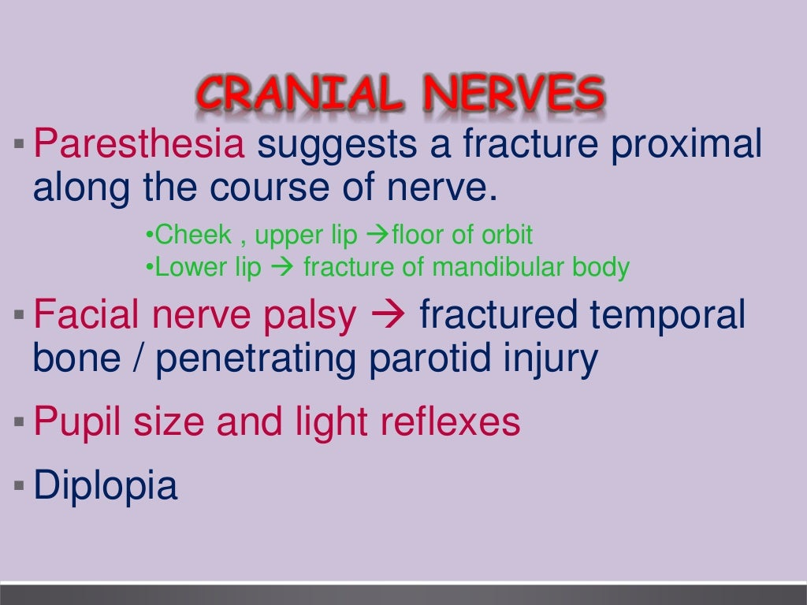

Slide 11
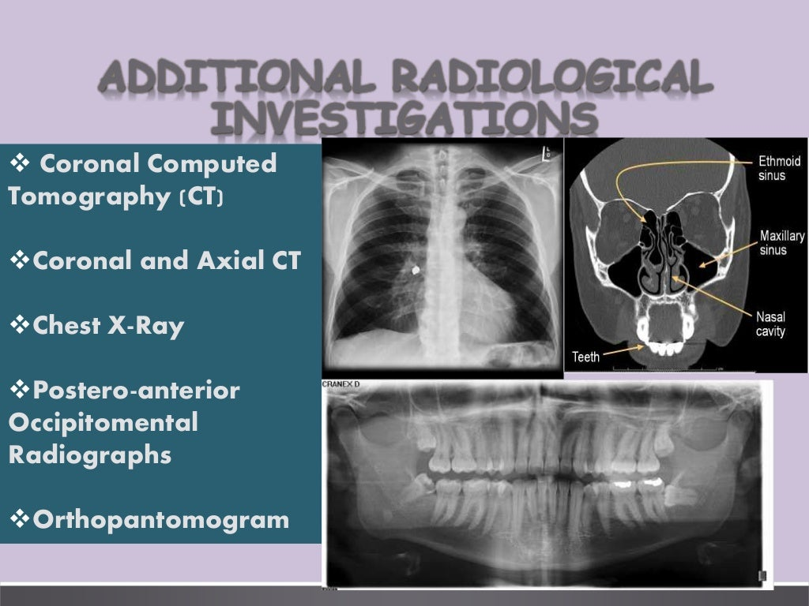

Slide 12
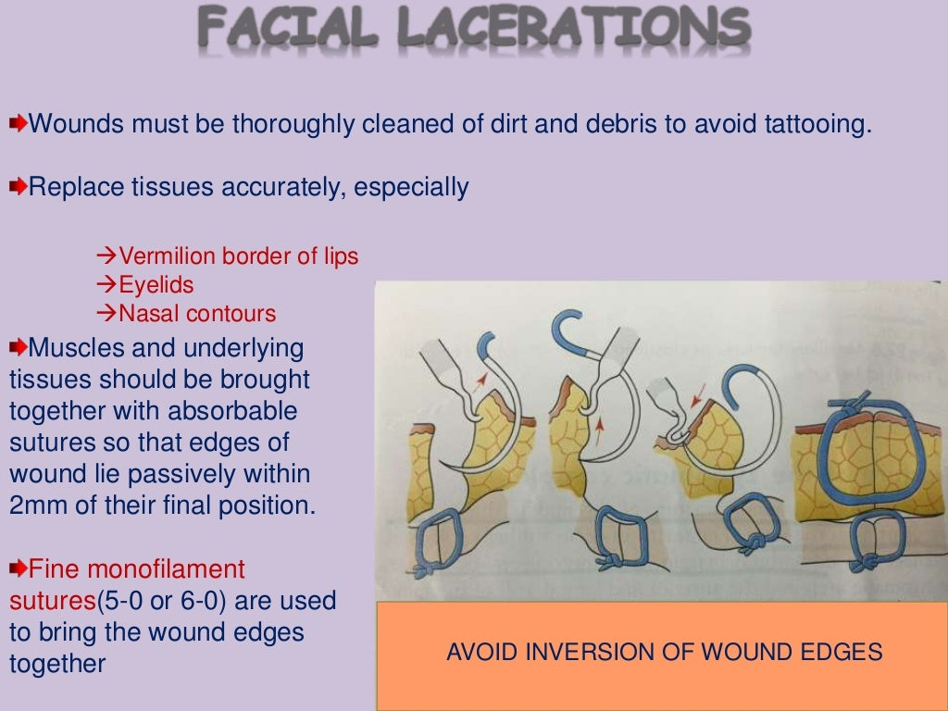

Slide 13
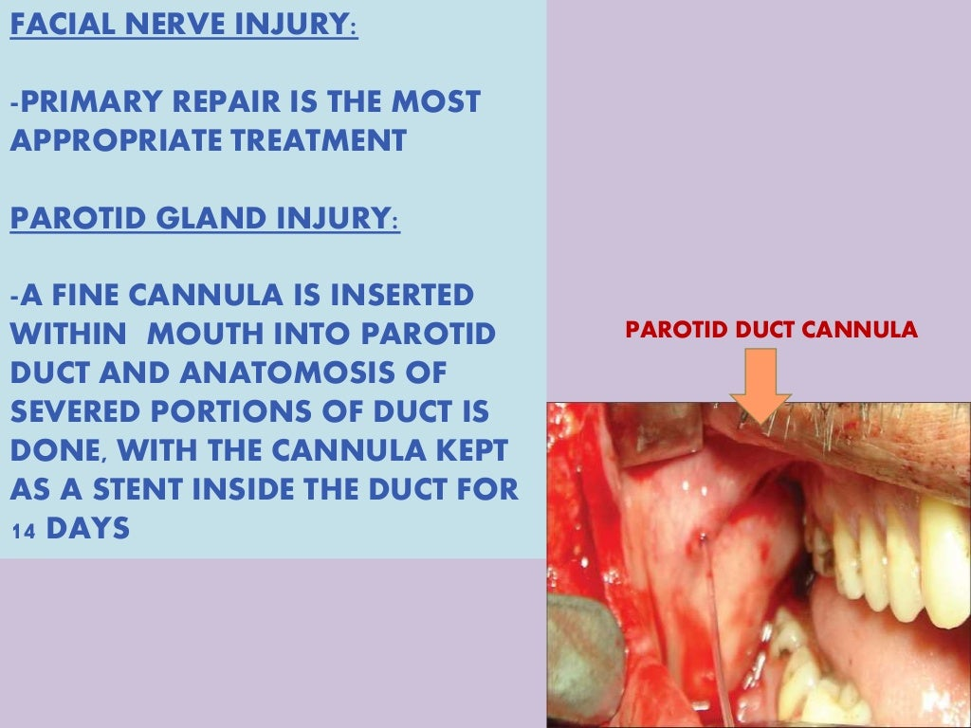

Slide 14
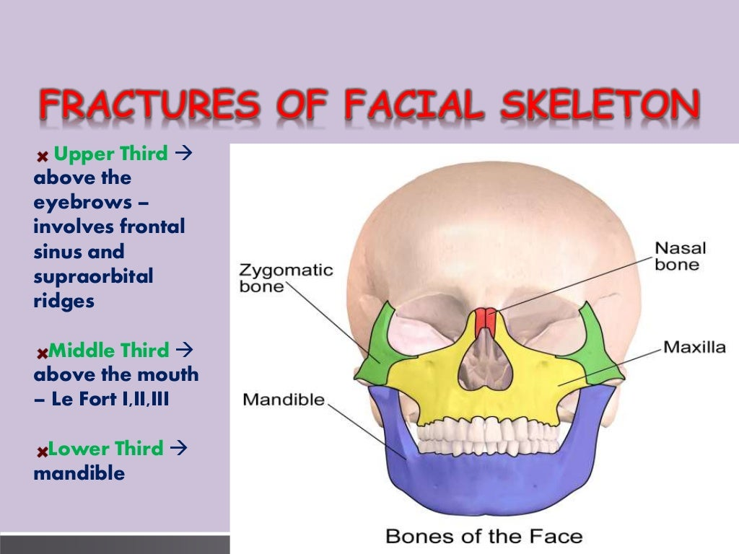

Slide 15
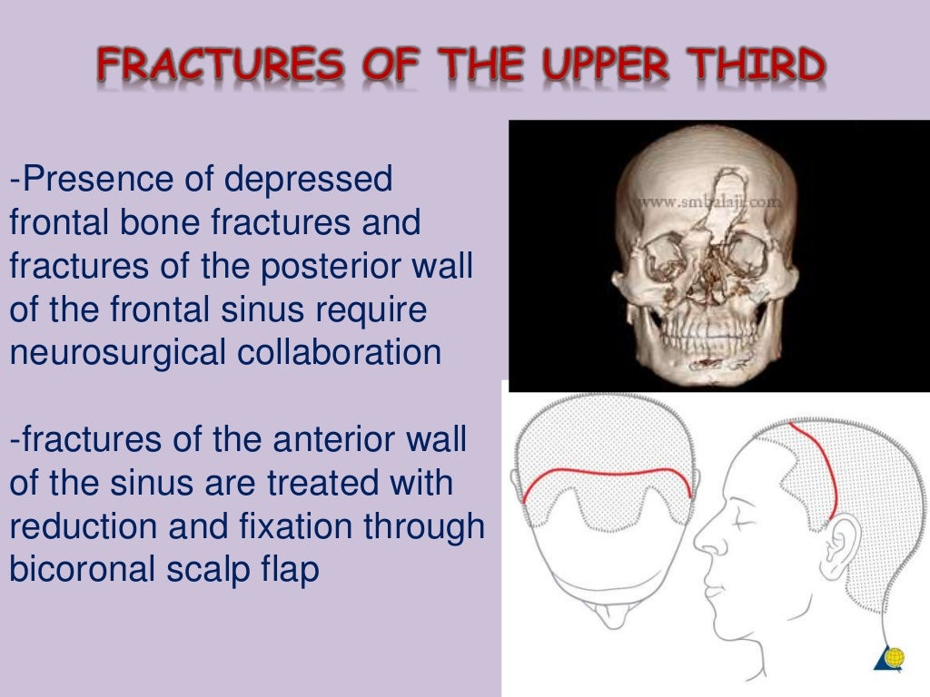

Slide 16
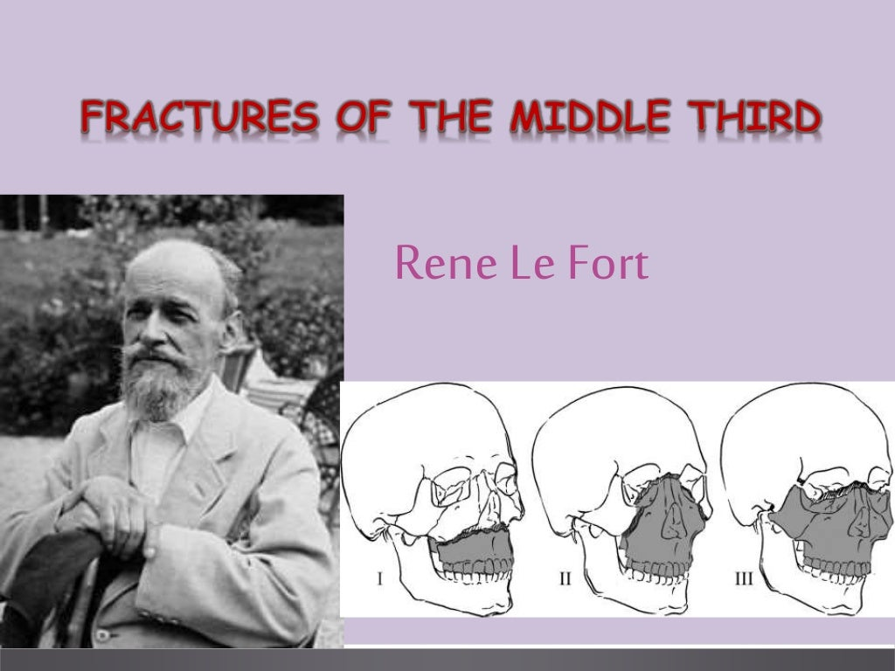

Slide 17
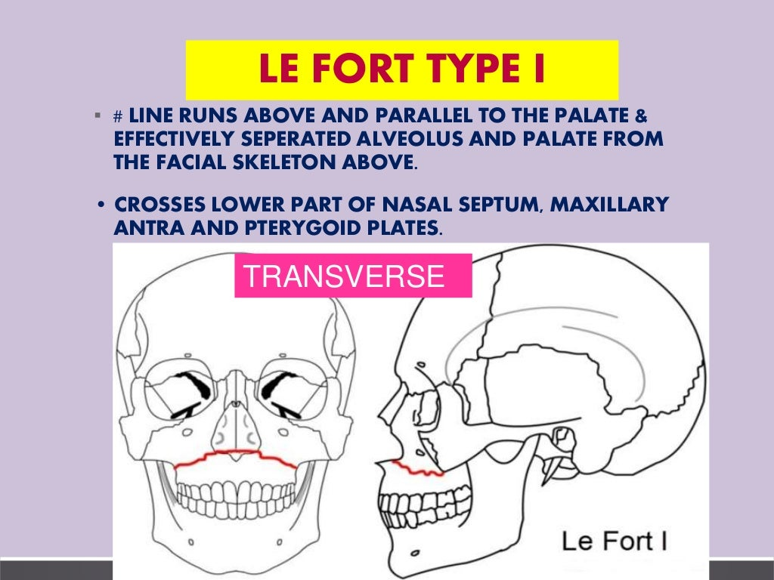

Slide 18
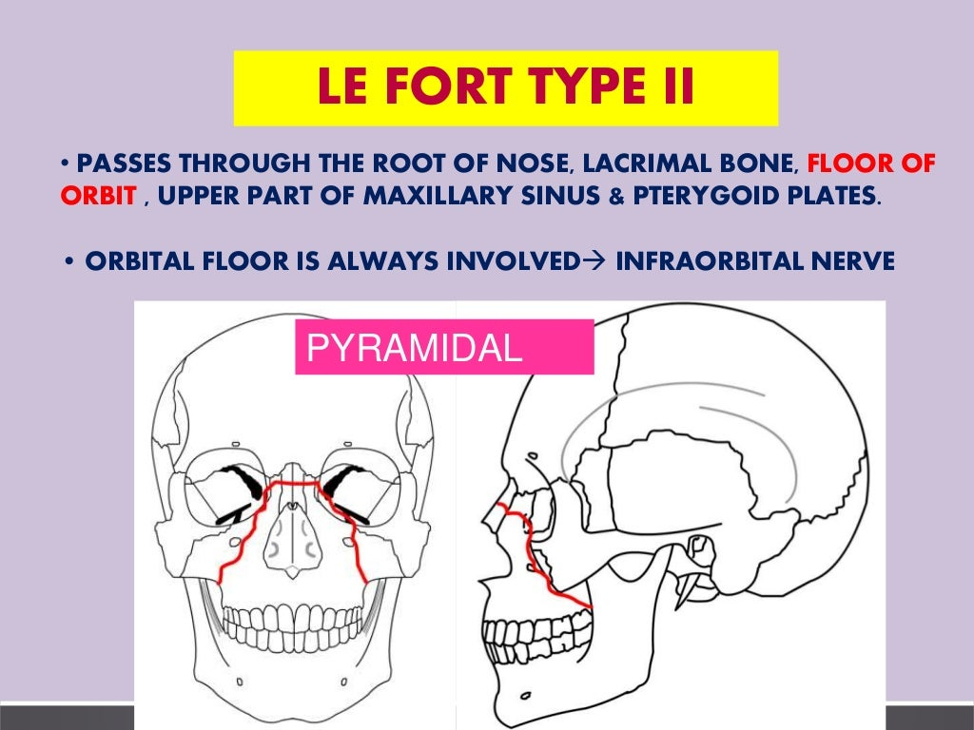

Slide 19
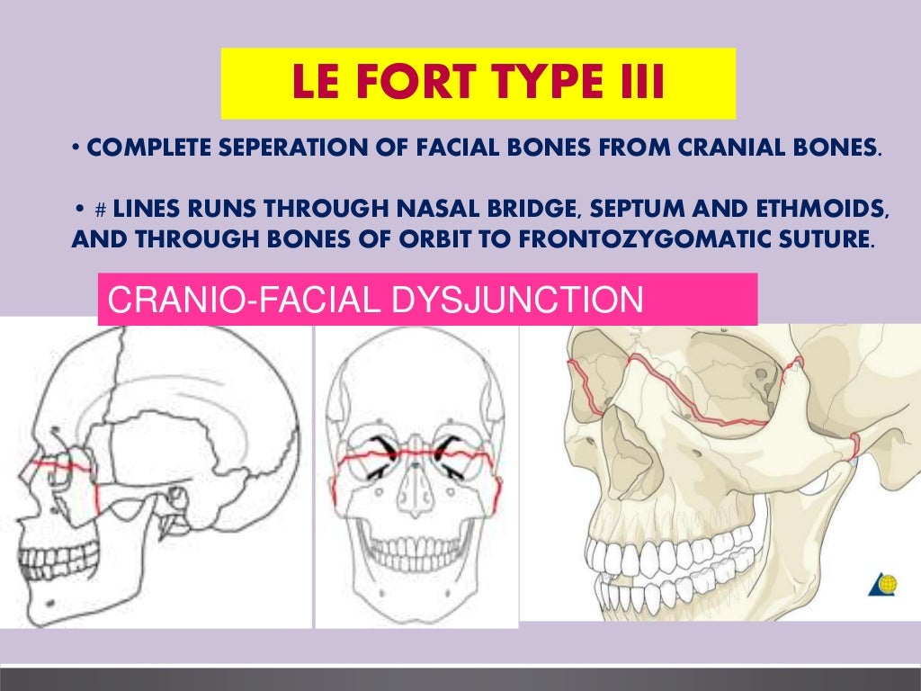

Slide 20
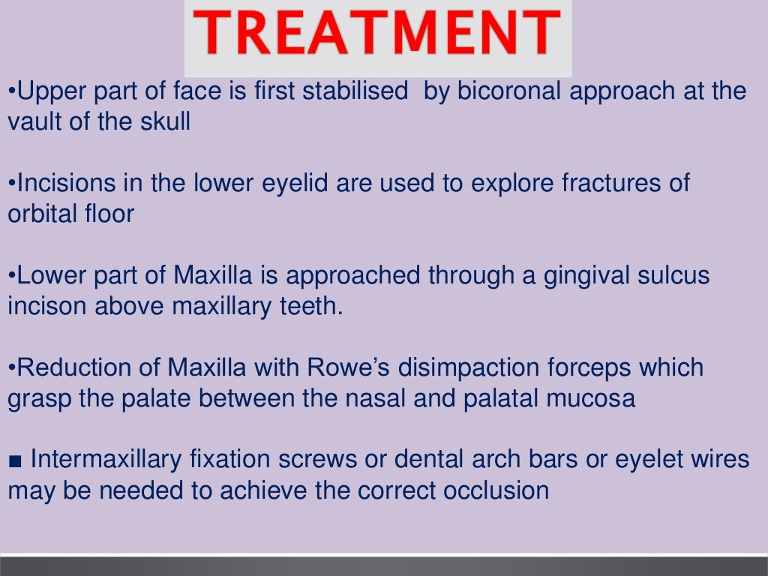

Slide 21
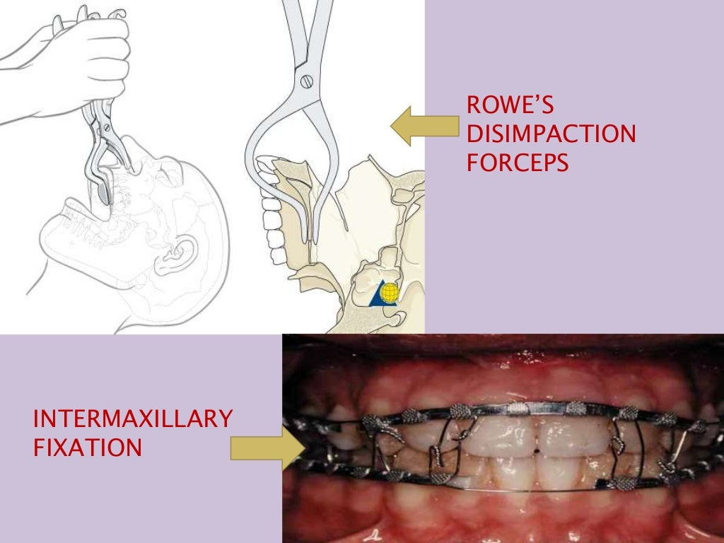

Slide 22
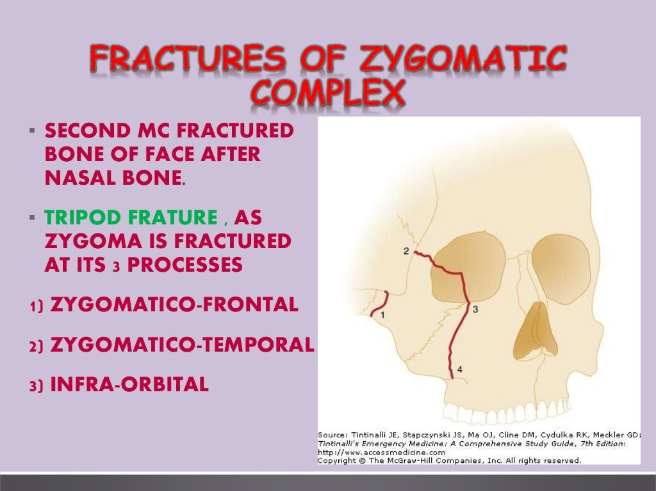

Slide 23
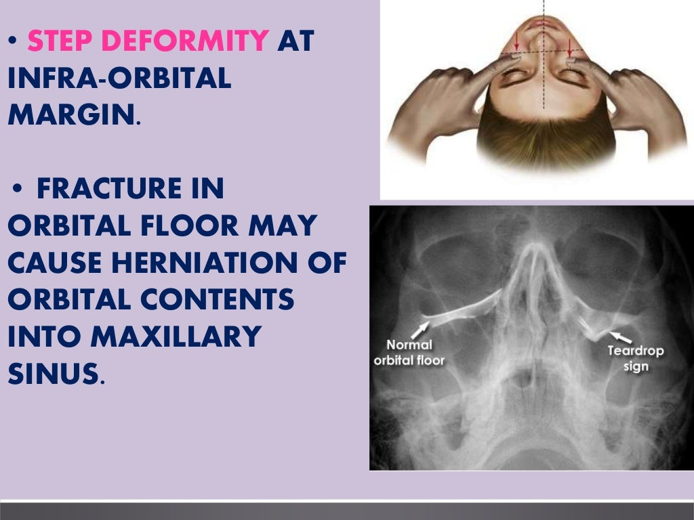

Slide 24
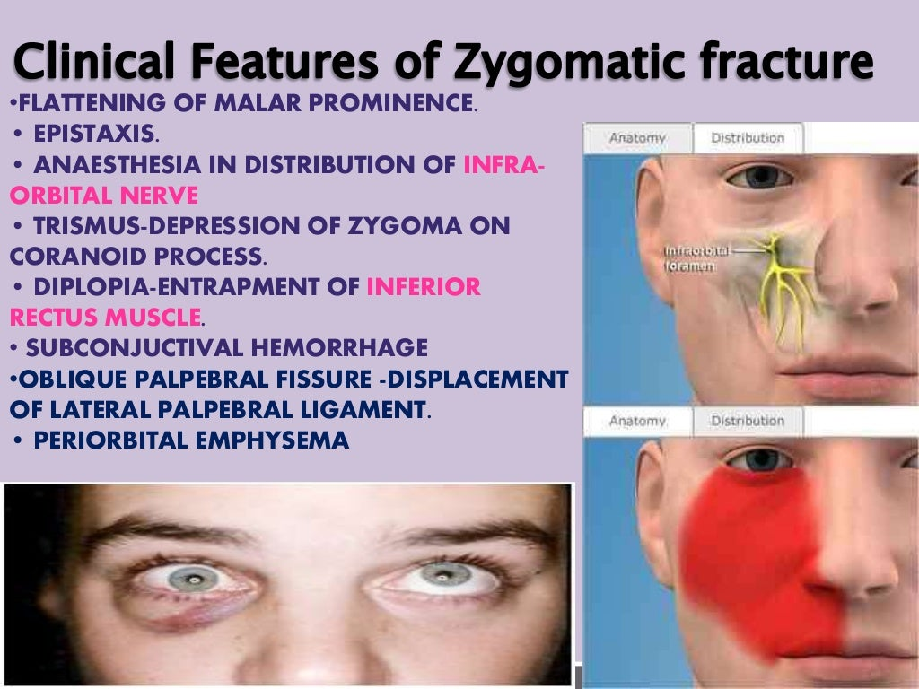

Slide 25
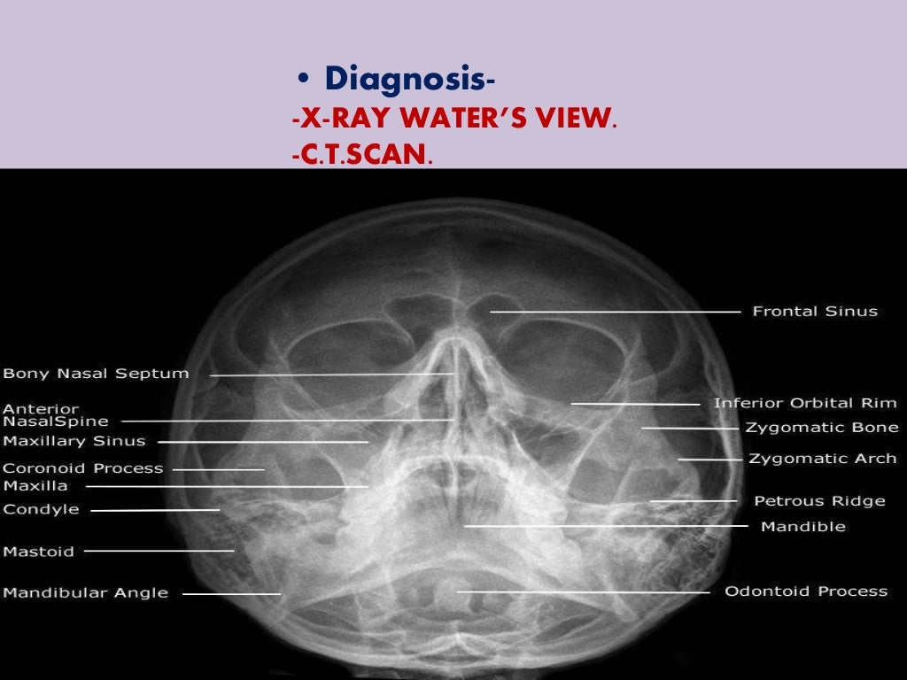

Slide 26
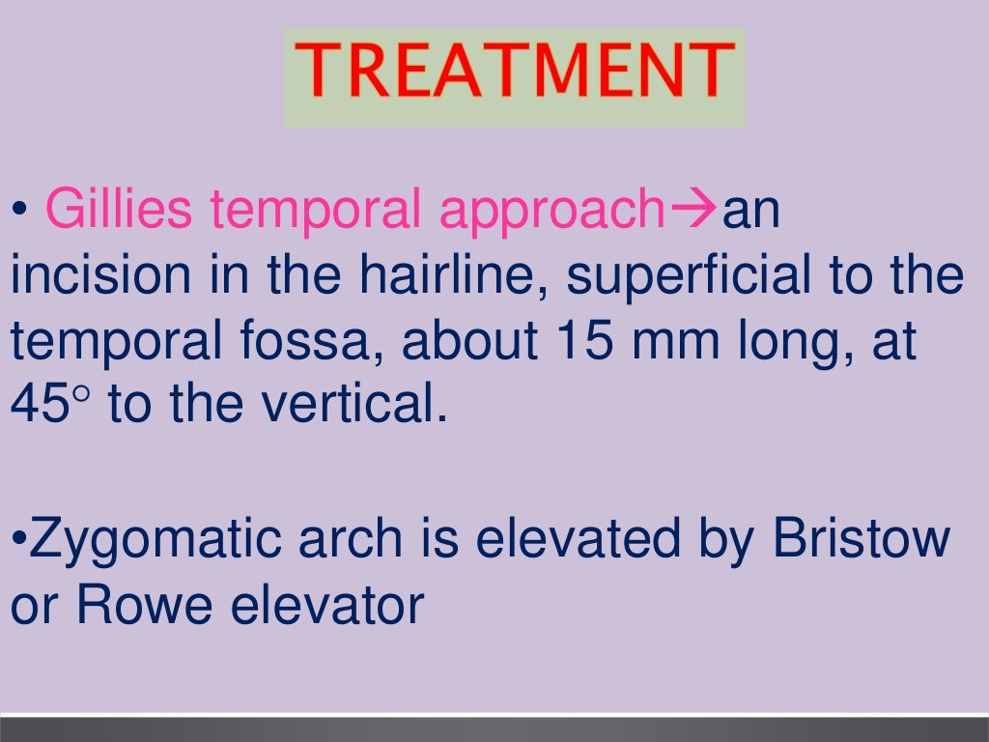

Slide 27
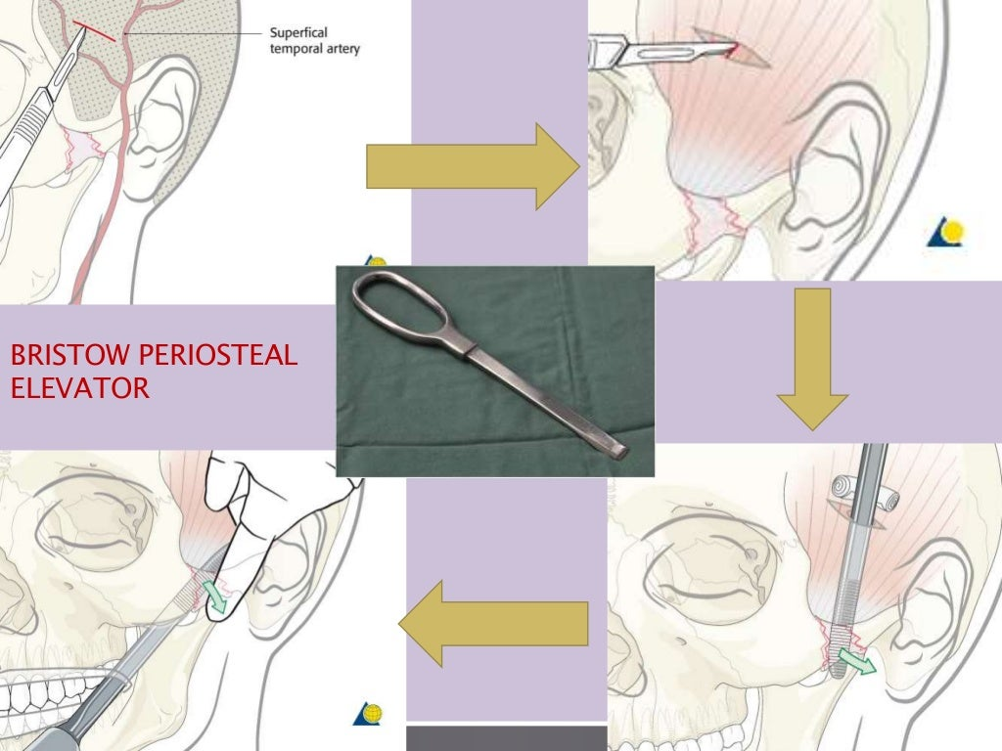

Slide 28
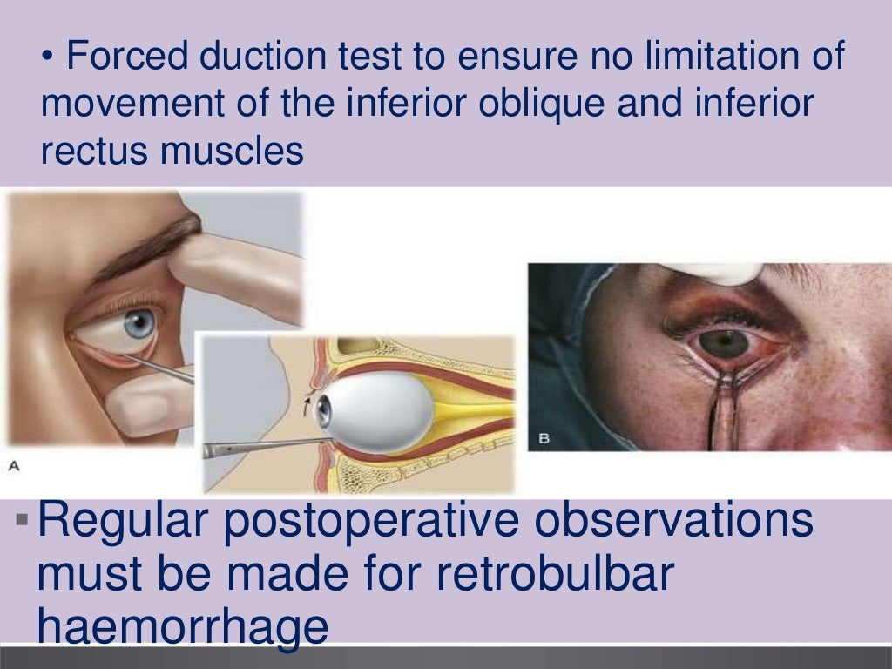

Slide 29
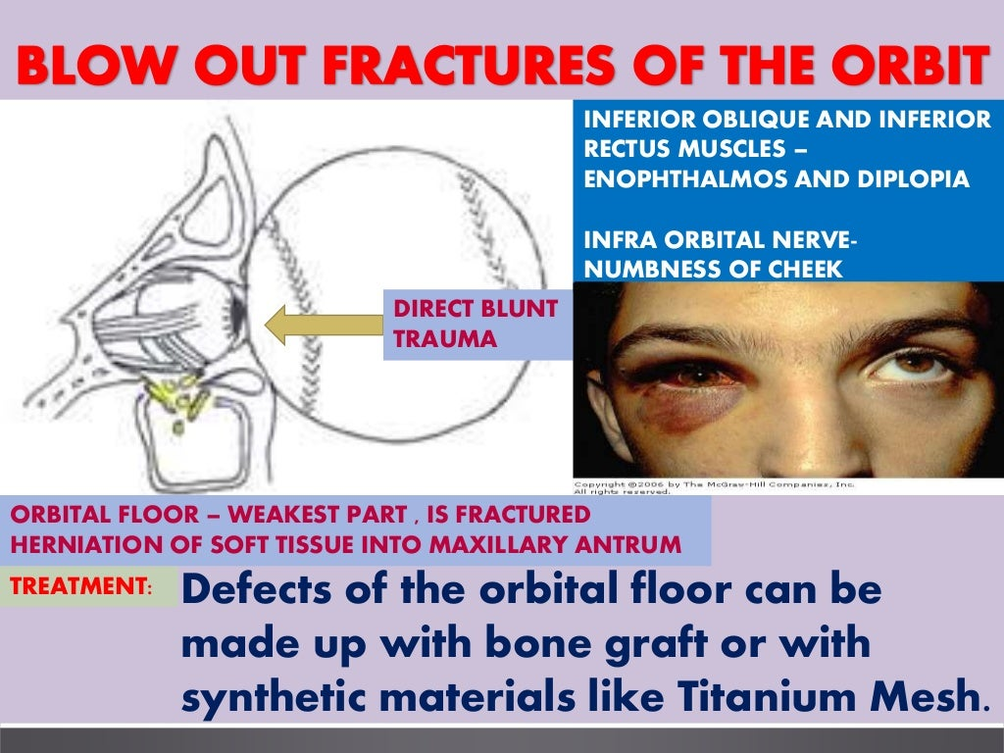

Slide 30
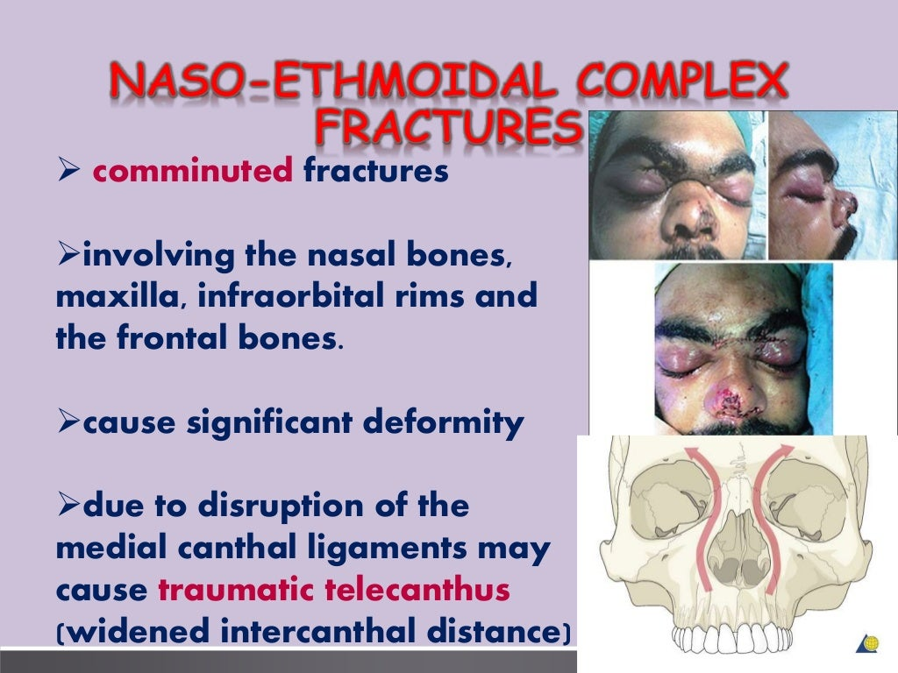

Slide 31
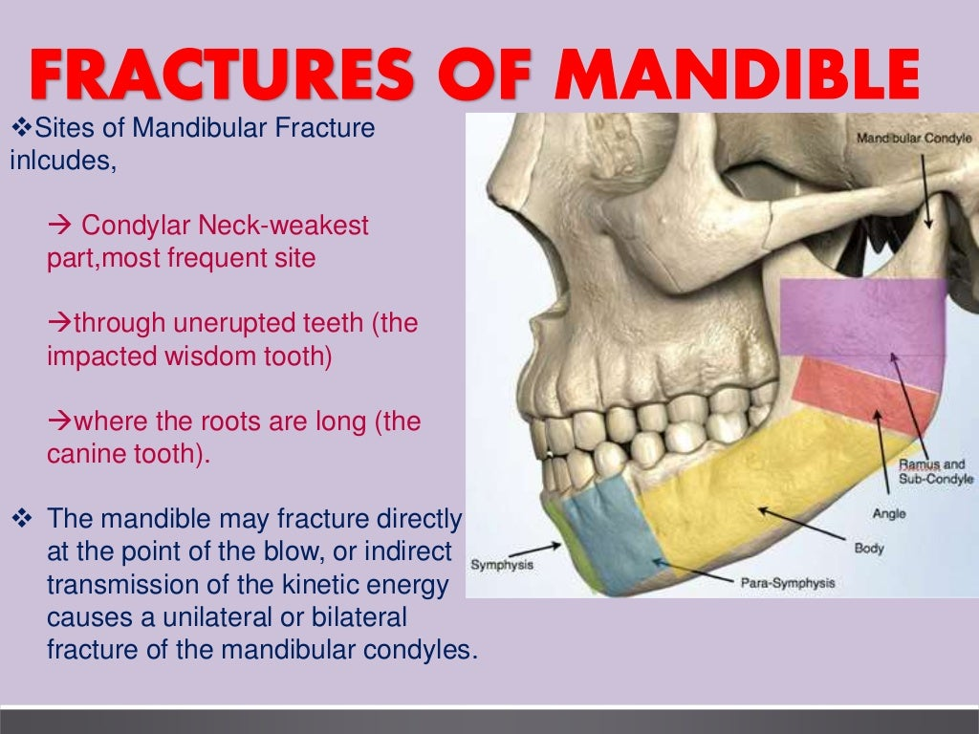

Slide 32
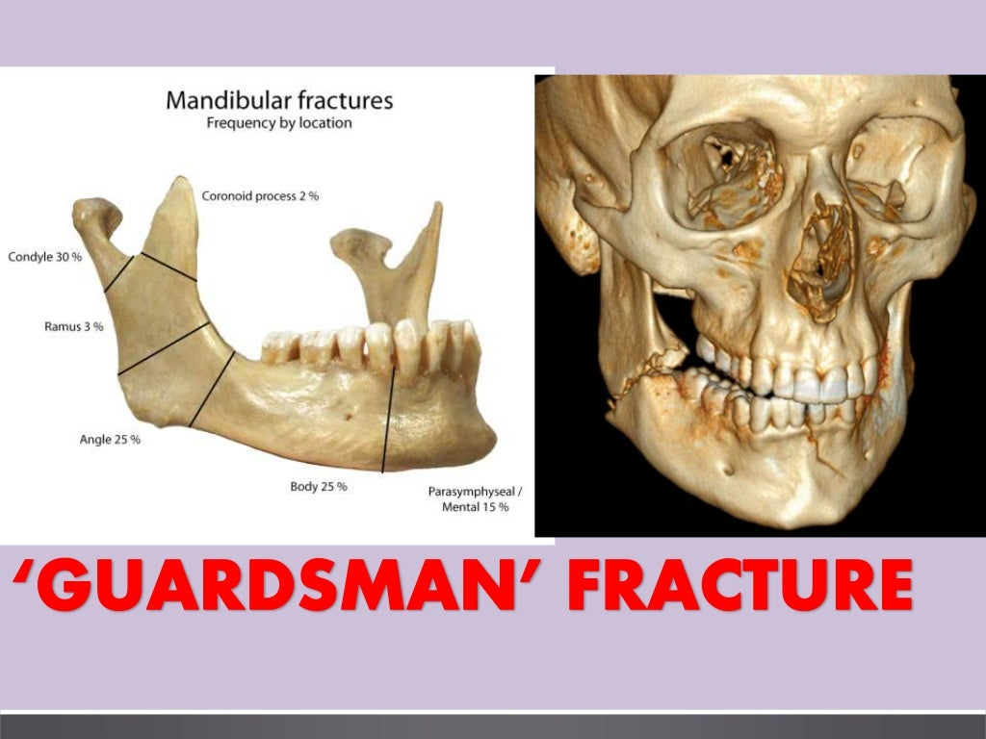

Slide 33
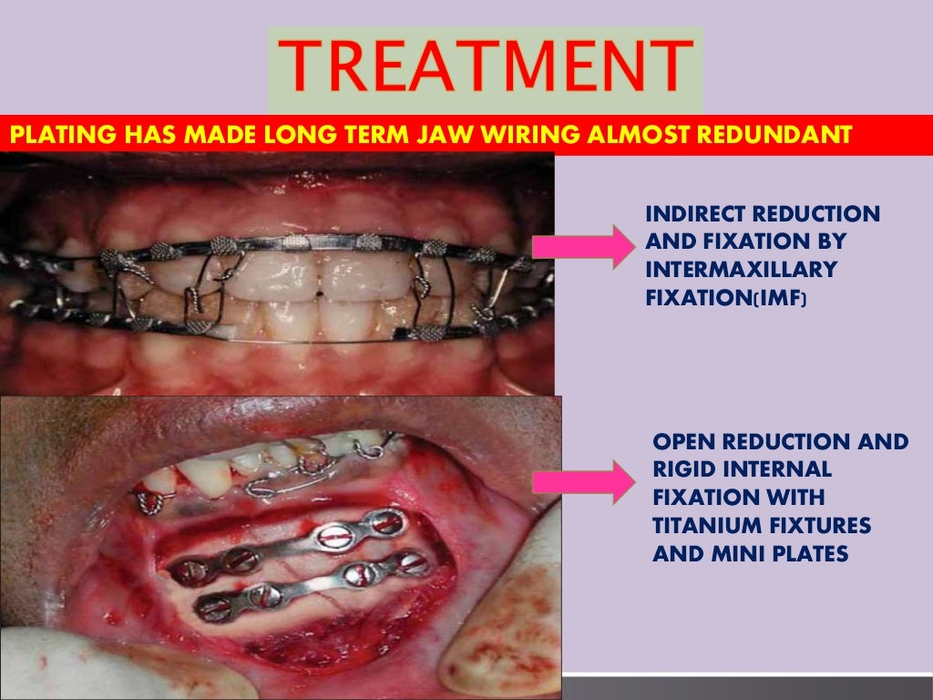

Slide 34
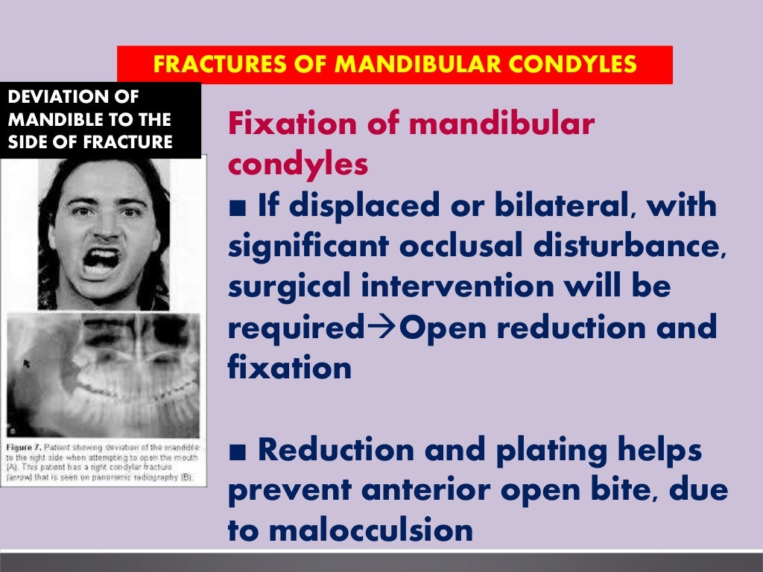

Slide 35
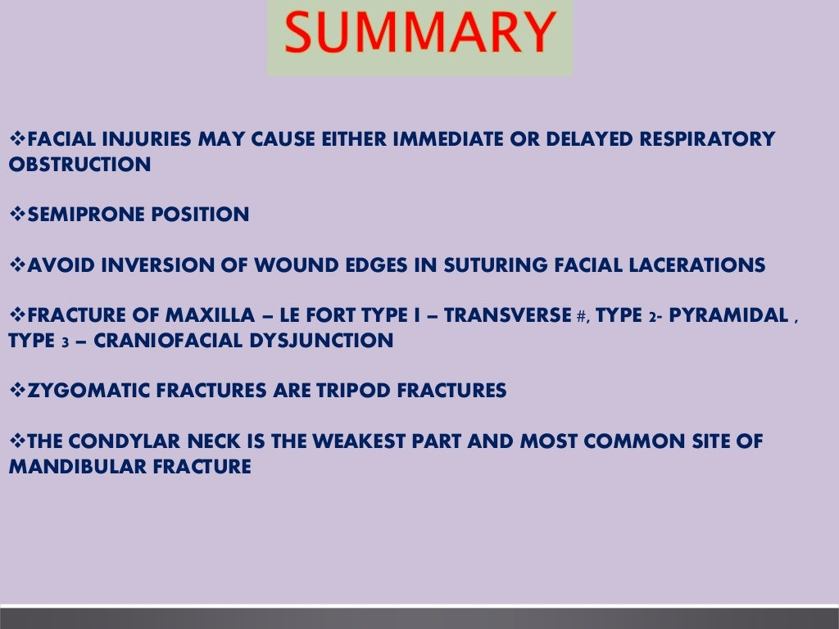

Slide 36
TAKE AWAY HOME MESSAGE
Fractures of facial bone are less frequent in children than adult
All the major studies show facial fractures are most common in males than in females.
Dentoalveolar fracture is found in 18-15% of children and is manage by wire splints.
Fractures of nasal bone are more frequent than fractures of maxilla and zygoma.

Slide 37
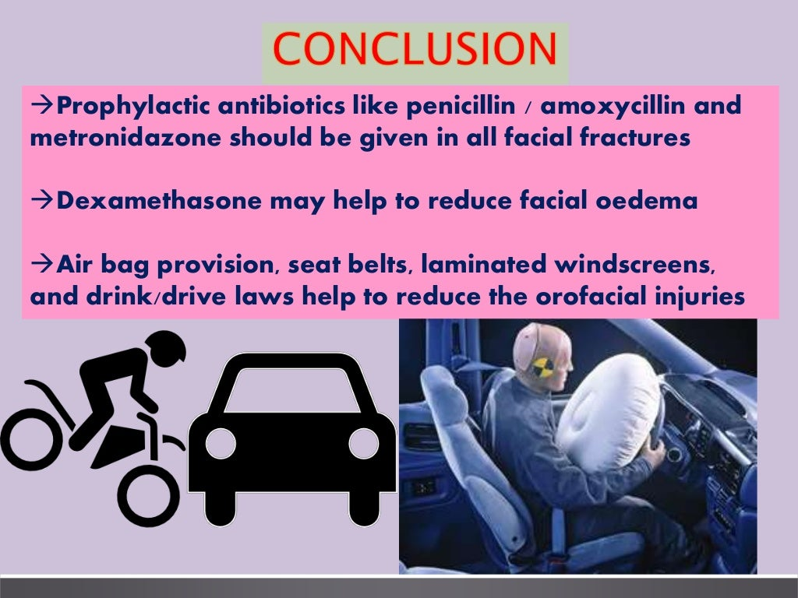

Slide 38
